Slide 1
QlikView
Eduardo Heidenreich
Buenos Aires, 2014

Slide 2
QlikView® es una plataforma
para Business Discovery.
Business Discovery
es ‘inteligencia de negocios definida por el usuario’.
Simplificando Decisiones para todos en todos lados
Notes:
So, how do we do this? QV is a business discovery platform (user driven BI) supporting the creation and consumption of analytic apps, to support better decision making.

Slide 3
Qlik En Números
30,000
100
Clientes
Países
1,500
36%
Partners
Crecimiento anual desde 2006

Slide 4







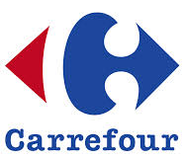















































Clientes: 5 a 50,000 Usuarios. 90% tasa de renovación
TECNOLOGÍA
FINANZAS
TELCOS
SALUD
CONSUMO
GOBIERNO & SERVICIOS PUBLICOS
Notes:
And we’re proven – with over 30,000 customers, renewing at a rate of 90%

Slide 5


























































400 Clientes en Argentina, Uruguay y Paraguay
INDUSTRIA
FINANZAS
AGRO
SALUD
CONSUMO
GOBIERNO & SERVICIOS PUBLICOS
Notes:
And we’re proven – with over 30,000 customers, renewing at a rate of 90%

Slide 6
¿Qué es lo que hace diferente a QlikView®?
Notes:
So, how do we do this?

Slide 7

QlikView®: El balance perfecto que provee
Máximo Valor de Decisión
Descriptivo Reportes & Visualizaciones
Diagnóstico Analítico & Descubrimiento
QlikView balancea BI, no tan sólo para describir o visualizar lo que ha pasado sino para descubrir por que.

Slide 8
Los Factores que hacen la diferencia QlikView®
Experiencia Natural Analytics™
Asociación + visualización = verdadero descubrimiento
Rápido valor agregado y prototipeo veloz
Modelo Apps de desarrollo: reusabilidad de objetos para mayor agilidad y enfoque
Governance: control donde se necesita; flexibilidad en el resto
Notes:
So what is it about QlikView that makes it different from other vendors?
First, it’s our Natural Analytics™ approach: we allow you to explore information naturally. You can think, decide and work in your natural – and best – way, rather than forcing you to adapt to the way business intelligence software traditionally works.
Data Dialogues™ help you can have meaningful conversations with your colleagues based on facts, not hunches. And you can reach consensus together.
With our Gorgeous + Genius approach, you gain a natural, easy, and comfortable experience that is visually beautiful.
You grow the number of users and use the growing volume of data – from individual, to department, to enterprise.
And with a quick time to implement, you shorten the time to value. It doesn’t take weeks or months to gain access to the information you need today.
Reusable objects deliver agility and control – for greater efficiency and speed
And all of this leads you to unanticipated value: answering the why’s, what if’s, and what’s next?

Slide 9
Notes:
So, how do we do this?

Slide 10
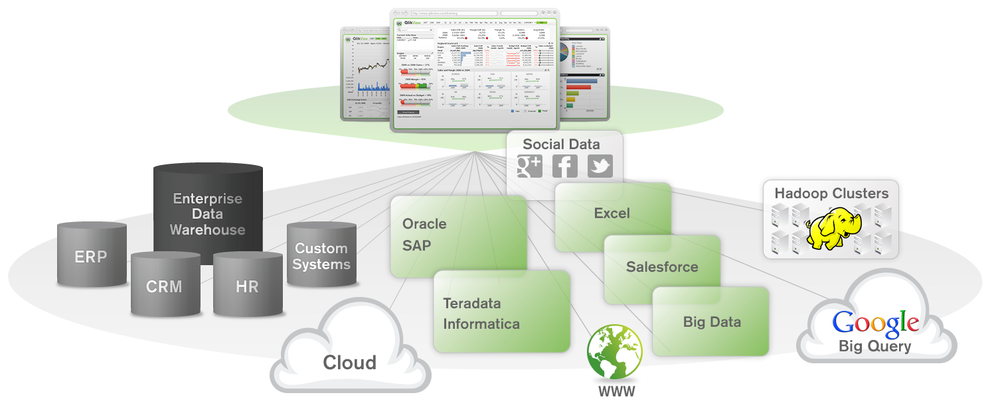
QlikView® accede a cualquier tipo de datos
…y conecta a todos los usuarios con la información
Notes:
Yes, Big Data is the big topic, but you need help harnessing and making sense of ALL your data. wherever it resides in your IT landscape. QlikView easily does this, making it natural for every user to access his or her data and perform analysis – whenever and wherever they need.
QlikView pulls from the data that resides in disparate systems across your company, seamlessly pulling it in and making associations to uncover what you’re looking for – and often, to reveal hidden treasures you had not anticipated.

Slide 11
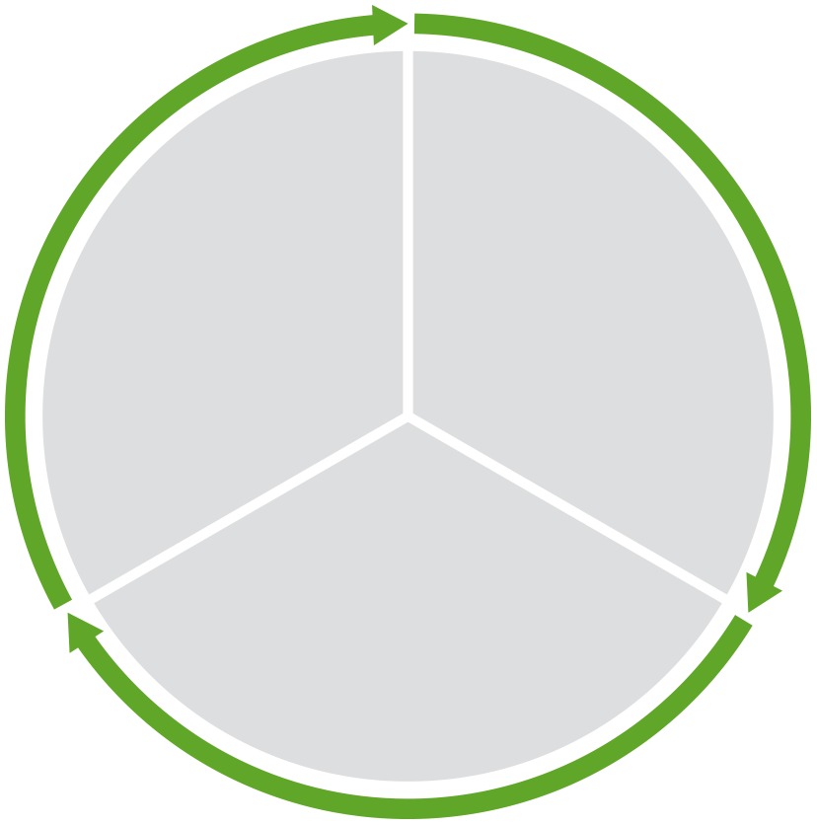
ROI de QlikView®
Dónde se obtiene el valor para el negocio
Reducción de costos:
Ahorro de tiempo
Menores gastos
Menor inventario
Menor costo de operación de la plataforma de BI
Mayores Ingresos
Aumento en ventas
Mejor margen
Oportunidades de cross-sell / upsell
cumplimiento regulatorio
y gestión de riesgos
Detección de fraude
Automatización de los reportes regulatorios
Reducción del riesgo
Notes:
There are many ways the 30k+ QlikView customers are achieving ROI with QlikView. Generally speaking, the ROI comes from one of 3 areas:
Cost Reduction
Revenue Optimization
Risk and Compliance

Slide 12
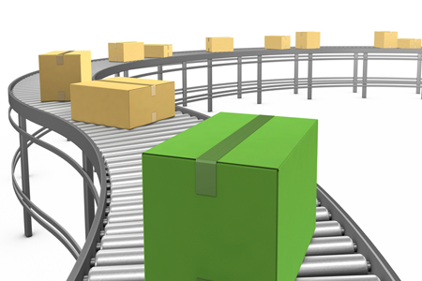

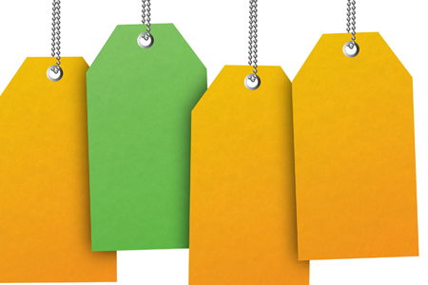



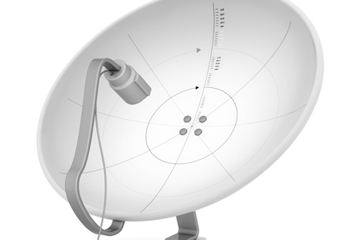
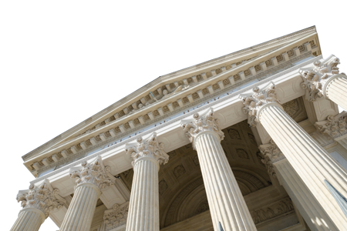
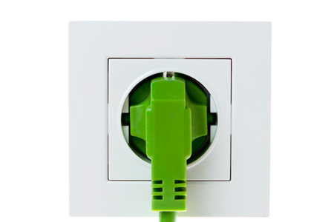
Soluciones QlikView por sector / industria
Manufactura
Supply Chain
Sales & Marketing Insights
Plant Operations
Servicios Financieros
Risk Management
Customer Intelligence
Cost Reduction
Consumo Masivo
Store Operations
Merchandise &
Supply Chain
Customer Intelligence
Salud
Clinical Excellence
& Outcomes
Operational Effectiveness
Finance & Performance
Improvement
Farma
Sales & Marketing
Effectiveness
Clinical & Operational
Excellence
Profit & Productivity Improvement
Medios de Comunicación
Customer Intelligence
Customer Self Service
Profitability & Revenue
Analysis
Sector Público
Government Spend Analysis
Workforce Performance
Crime Analysis & Intelligence
Energy & Utilities
Operational Efficiency
Smart metering
Billing & Revenue Analysis
Notes:
Public facing slide

Slide 13

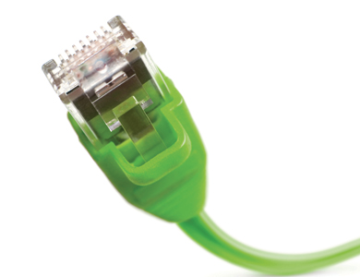


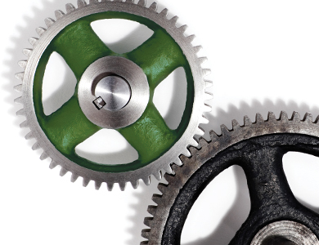
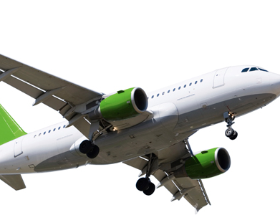
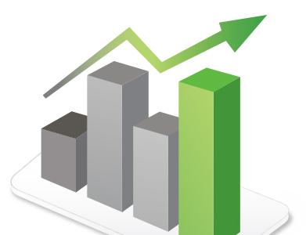
Soluciones QlikView® por función
Adm y Finanzas
Financial Planning
& Analysis
Expense Management
Revenue & Profitability
Cash-Flow & Balance Sheet
Risk & Compliance
IT (como usuario)
Helpdesk Management
IT Infrastructure
Software & License
Network Governance
Recursos Humanos
Workforce Management
Total Rewards
Recruitment
Marketing
Campaign Performance
Customer Segmentation
Web Analytics
Operaciones
Production Efficiency
Operational Risk
R&D and Innovation
Supply Chain
Procurement
Inventory
Logistics
Ventas
Sales Enablement
Sales Management
Notes:
Public facing slide

Slide 14

¿ Qué hacen las Empresas con QlikView® ?
Mejorar la toma de decisiones
Incrementar la Velocidad y Agilidad para ejecutar
Cambiar la manera en que operan
Resolver problemas relacionados con cambios en los datos/información
Notes:
QlikView supports what companies need to do in the new reality of today’s business.
Improve decision making in an increasingly complex data environment
Deliver greater speed and agility in line with the pace of business
Transform the way they think about and run their operations
Address information needs of individuals in a way that drives overall value for the business

Slide 15
Business Discovery: Beneficios Empresariales
Visibilidad
Confianza
Productividad
Velocidad de Decisión
Alineamiento
Agilidad
Governance
Proceso Colaborativo de Toma de Decisiones

Slide 16
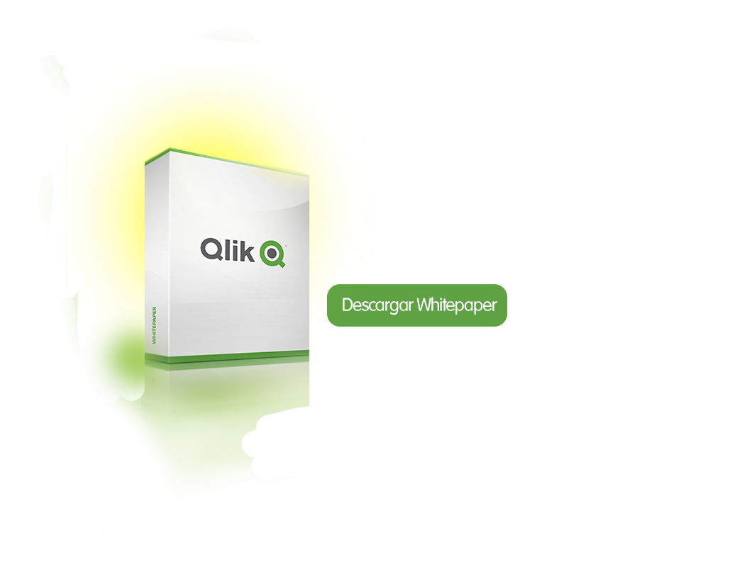
Notes:
So, how do we do this?

